Slide 1

High-Performance Software Pipeline for Single Molecule Tracking Data
Dec. 4, 2017
Sun Jay Yoo – Wu Lab / HHMI

Slide 2
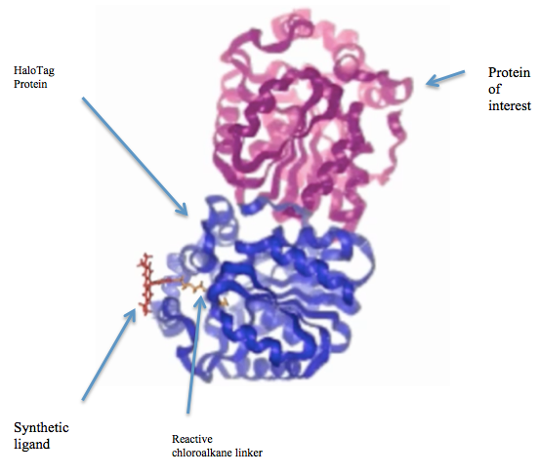
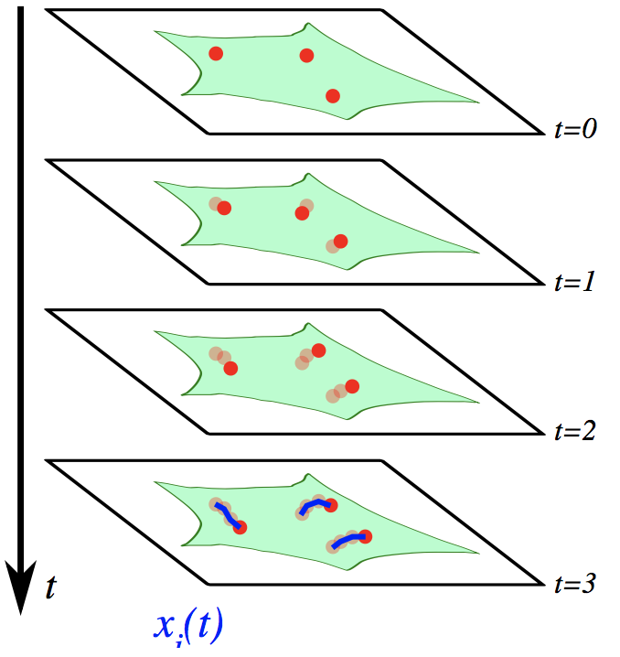
General Overview
Fluorescent biomarkers and tags
Super-resolution single molecule imaging
Mechanistic and conceptual models for underlying cell processes

Slide 3
General Overview
Fluorescent biomarkers and tags
Super-resolution single molecule imaging
Positions on nanometer scale (~30nm)
Movement in millisecond scale (~10ms)

Slide 4

General Overview
Super-resolution single molecule imaging

Slide 5

General Overview
With thresholding
Super-resolution single molecule imaging

Slide 6
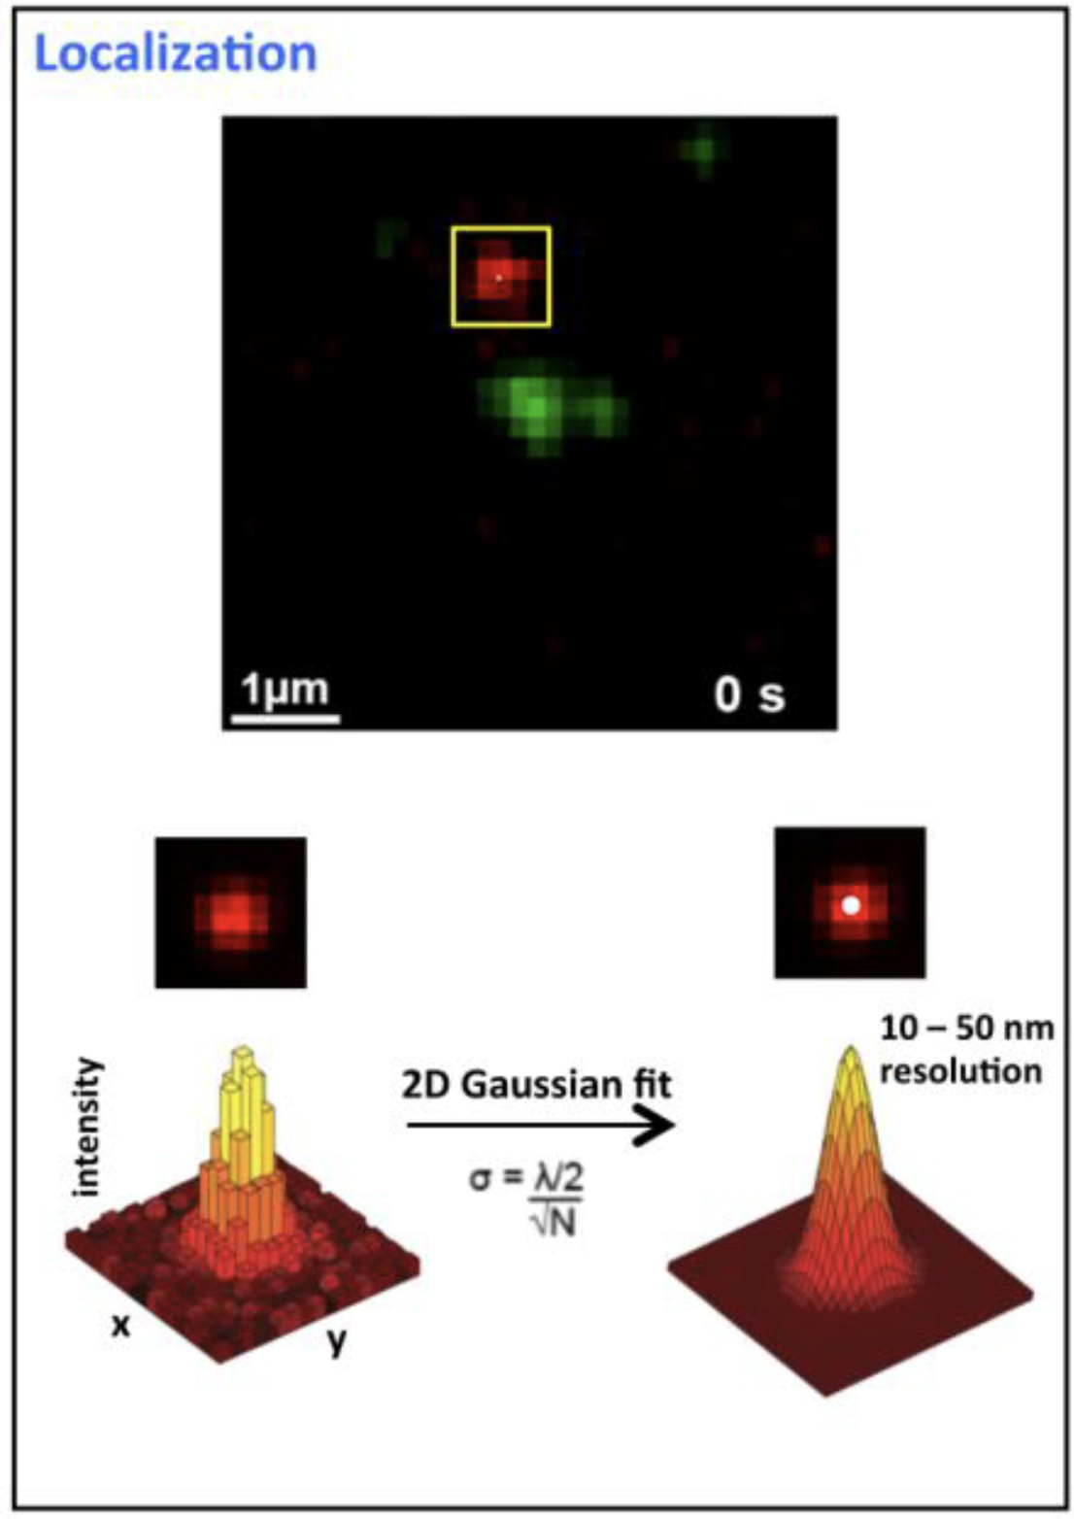
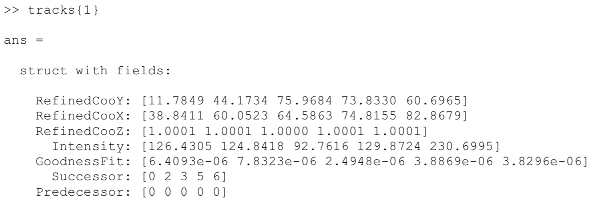
General Overview
Super-resolution single molecule imaging

Slide 7
General Overview
Super-resolution single molecule imaging
Mechanistic and conceptual models for underlying cell processes
?

Slide 8
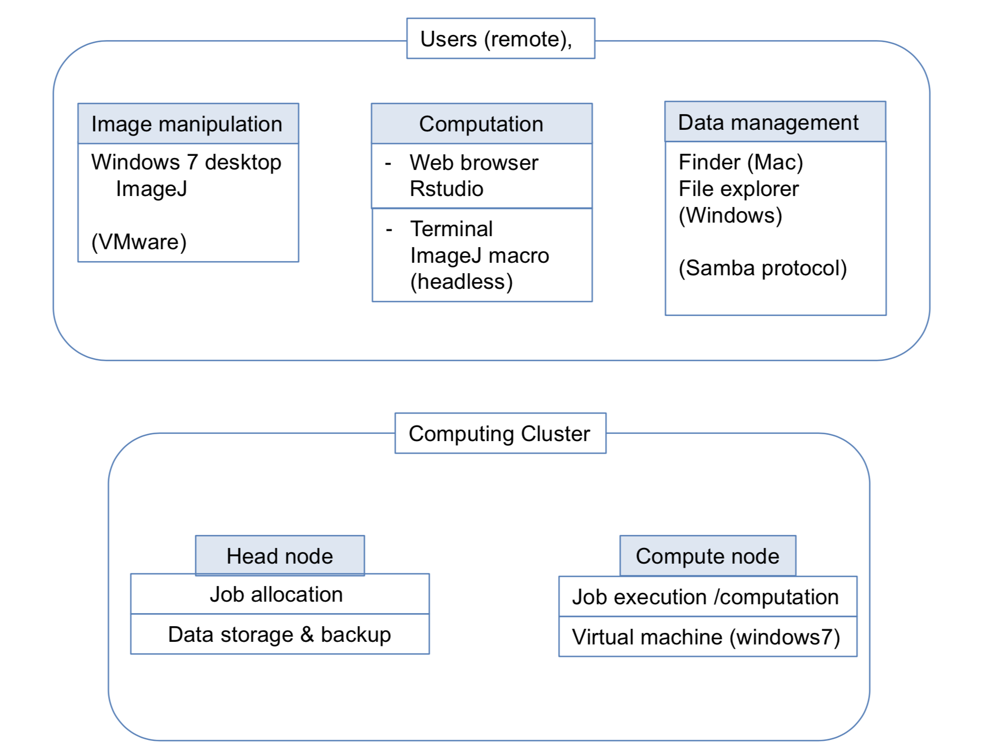
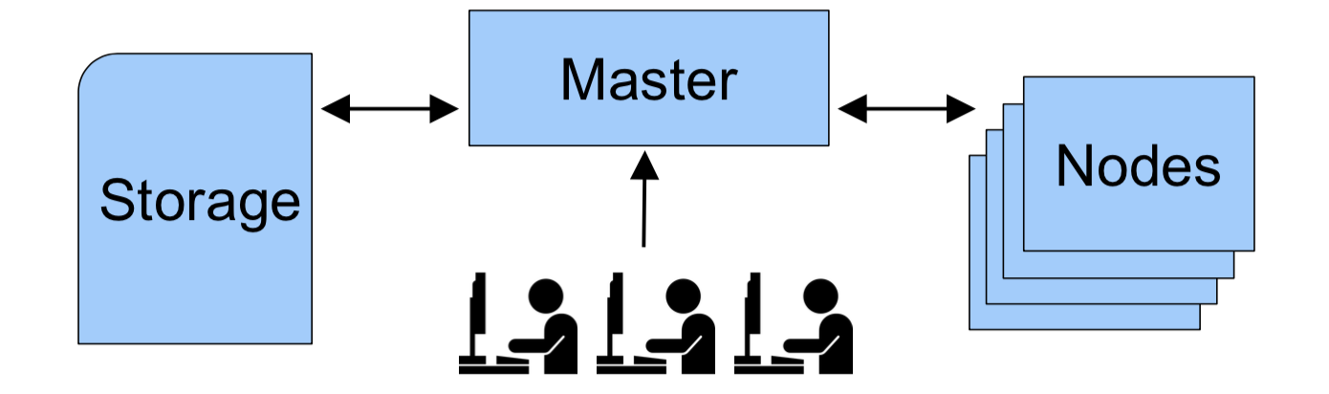
Preliminary Setup
High performance compute cluster
File server and remote workstation

Slide 9
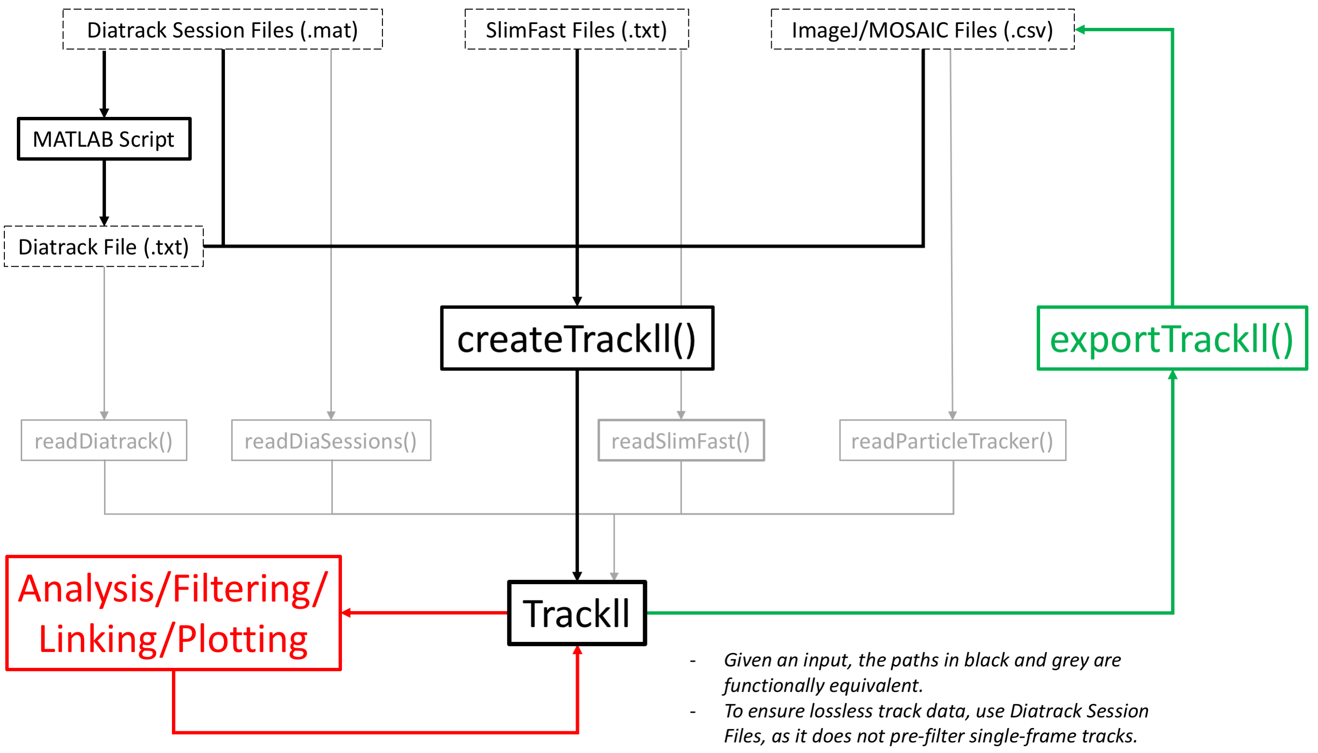
The Software
~ 8000 lines of code

Slide 10
Reading Single Molecule Tracks
1

Slide 11
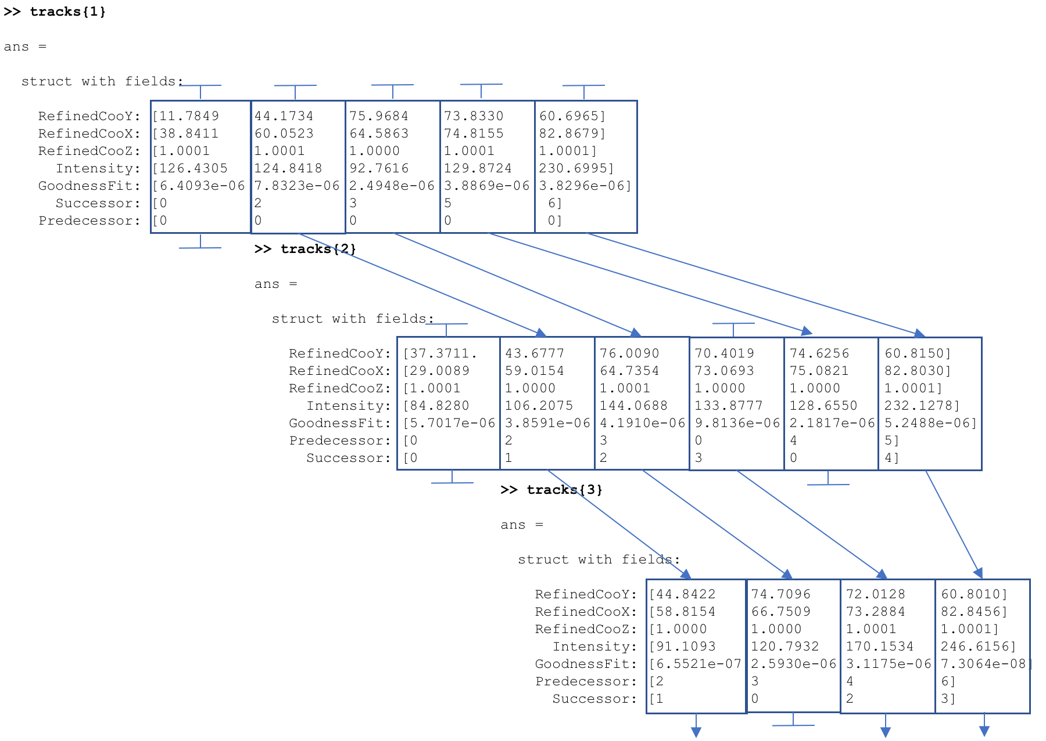
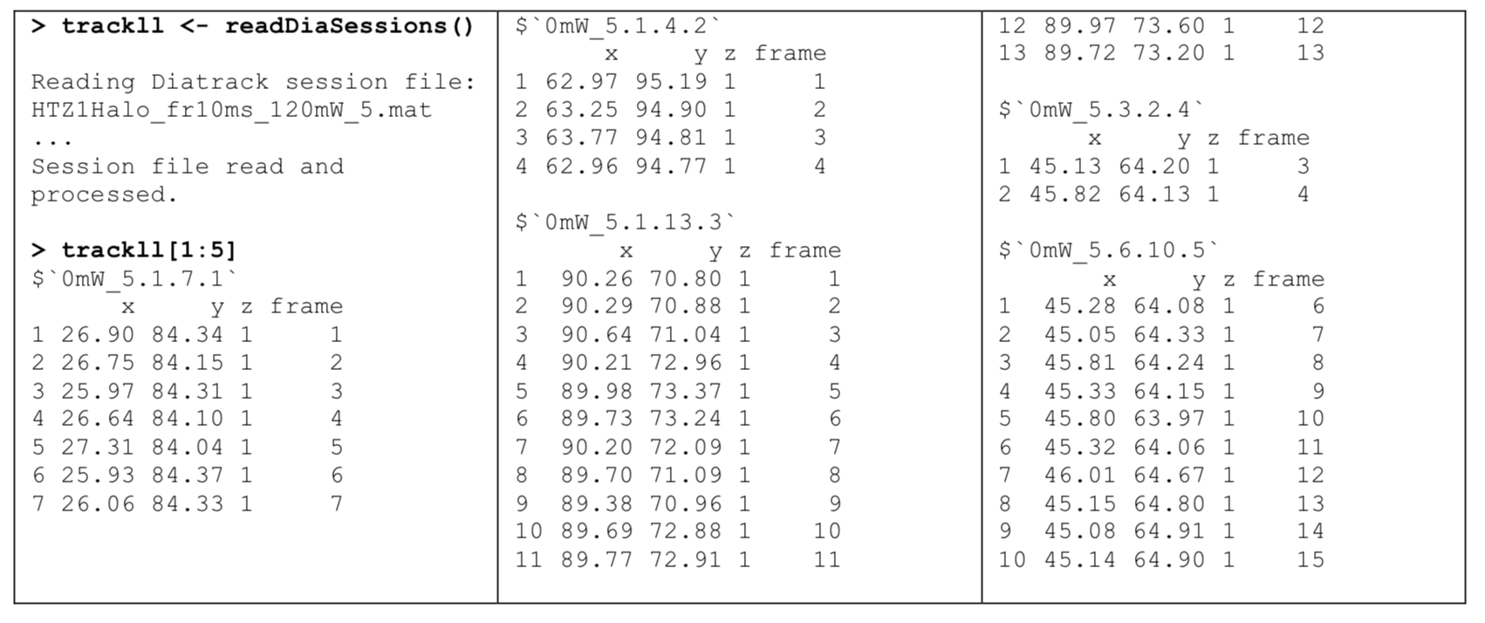
Reading Single Molecule Tracks

Slide 12
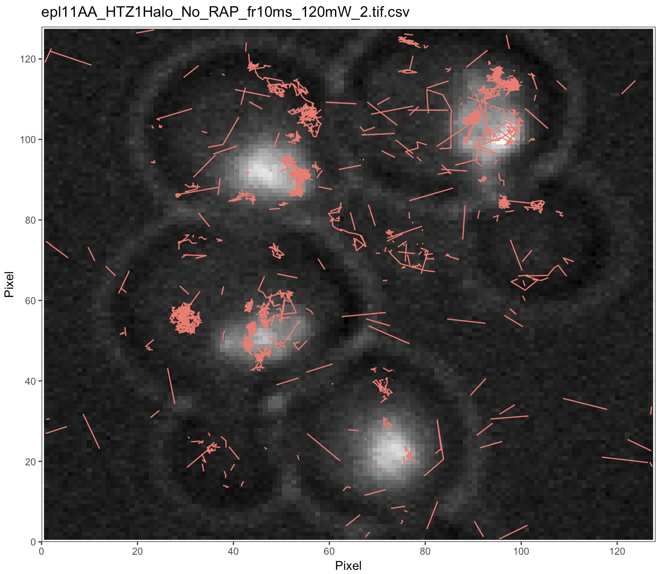
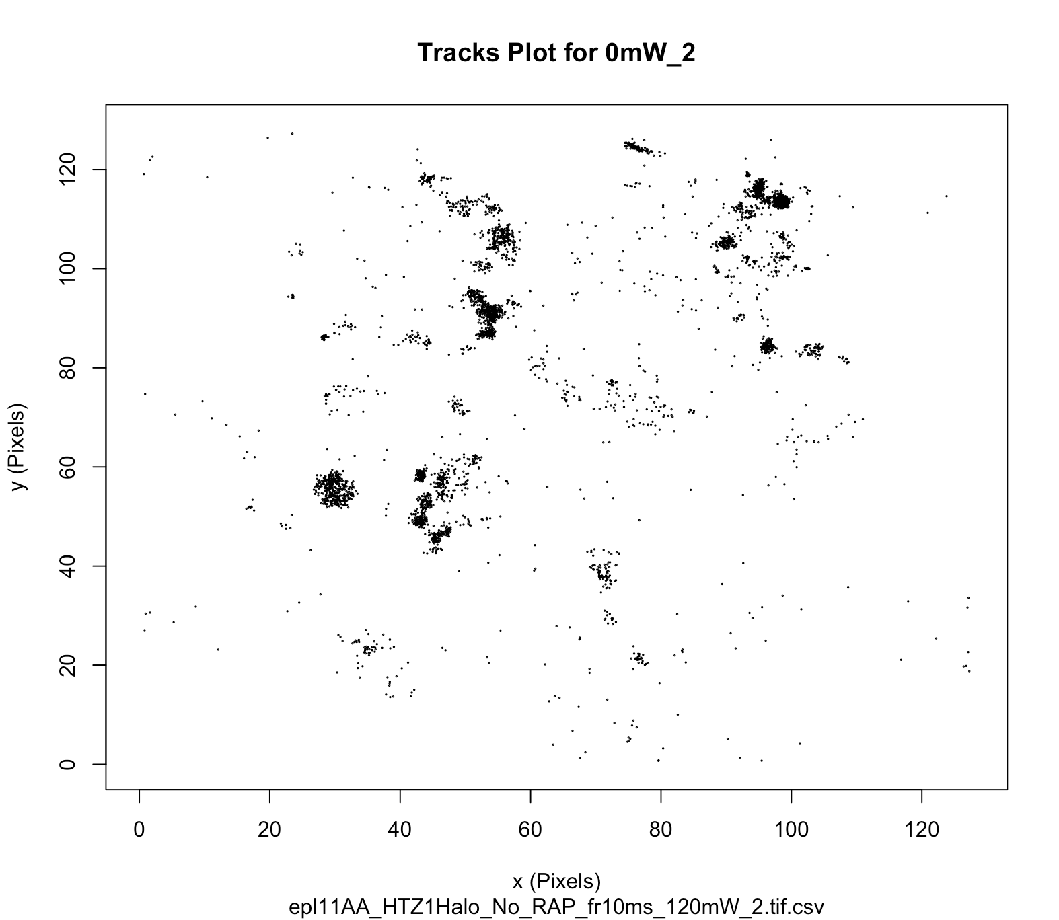
Reading Single Molecule Tracks

Slide 13
Refining Data
2

Slide 14
Refining Data
Filtering
Linking
Trimming
Merging
Masking
Masking *

Slide 15

Refining Data
Manually masking

Slide 16
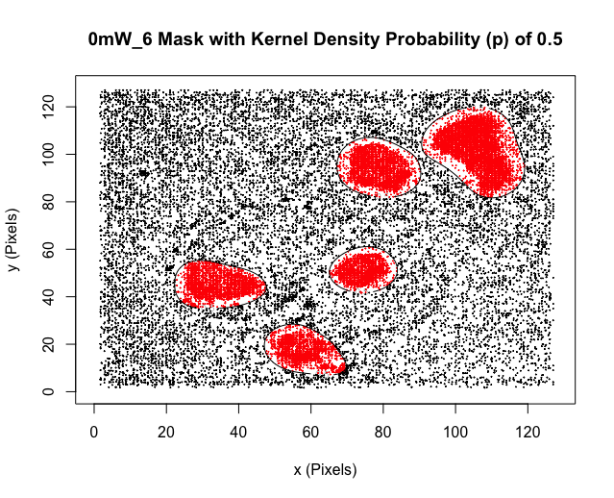
Refining Data
Masking by kernel density

Slide 17
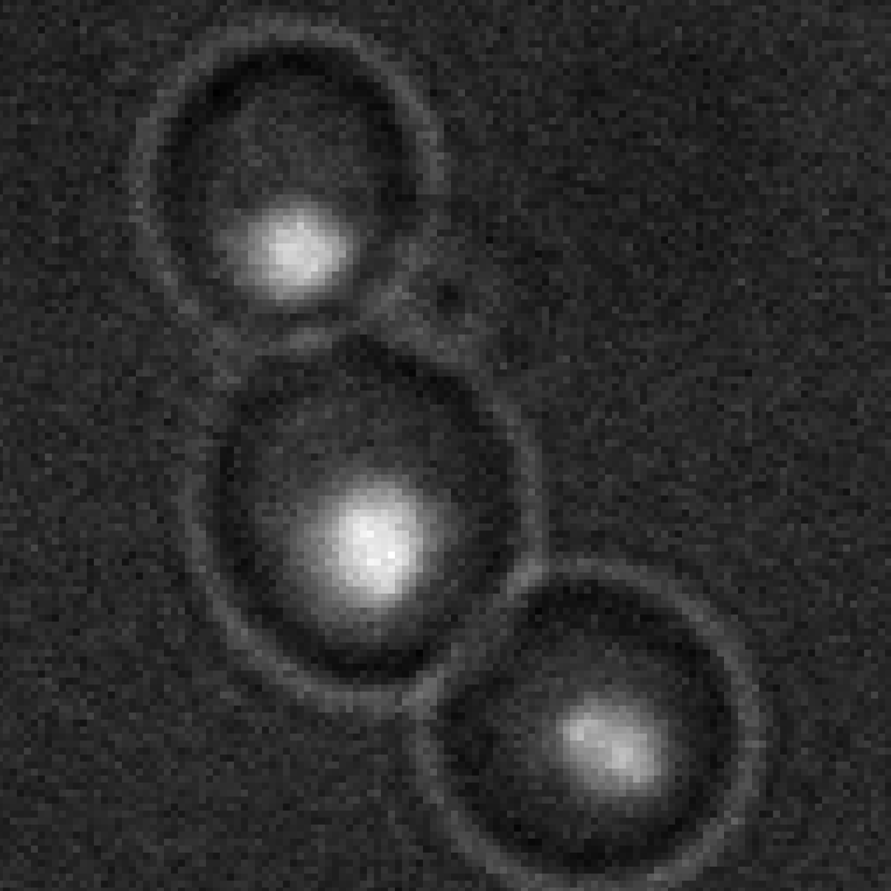
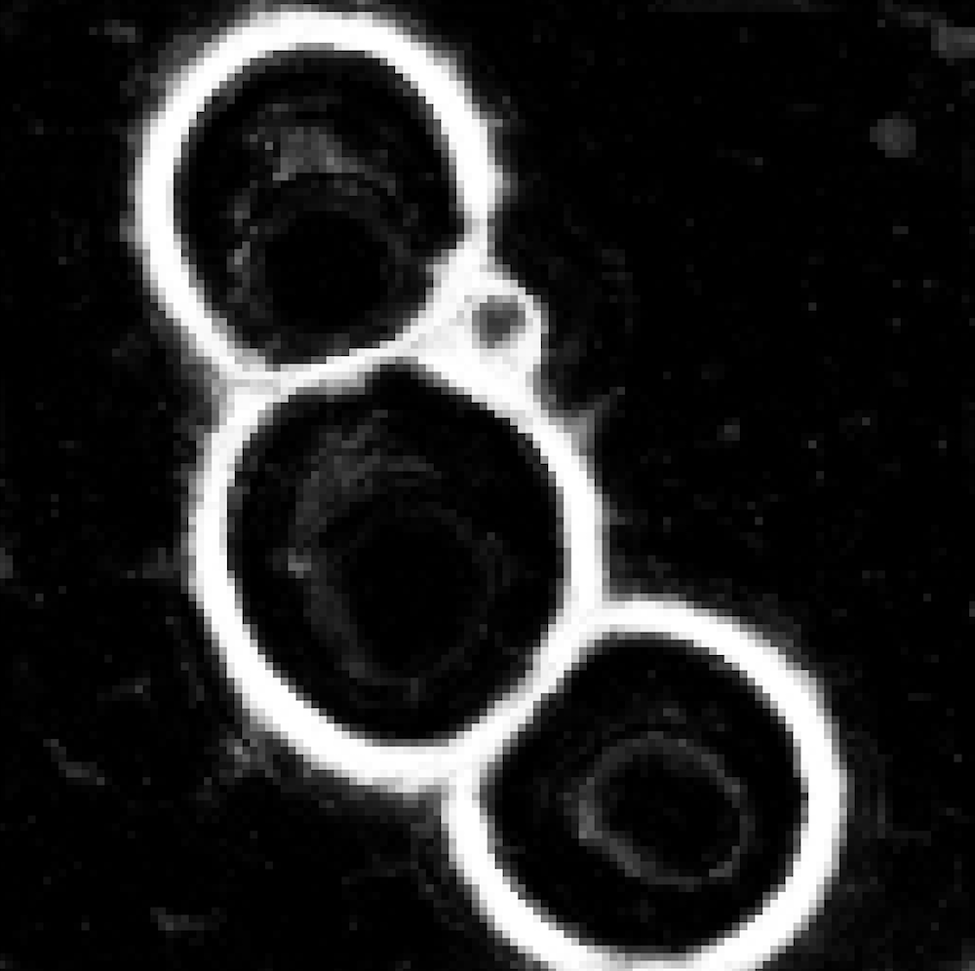

Refining Data
Masking by segmentation and extraction

Slide 18
Refining Data
Circle detection using the Hough transform
Simple cell segmentation

Slide 19
Analyzing Data
3

Slide 20
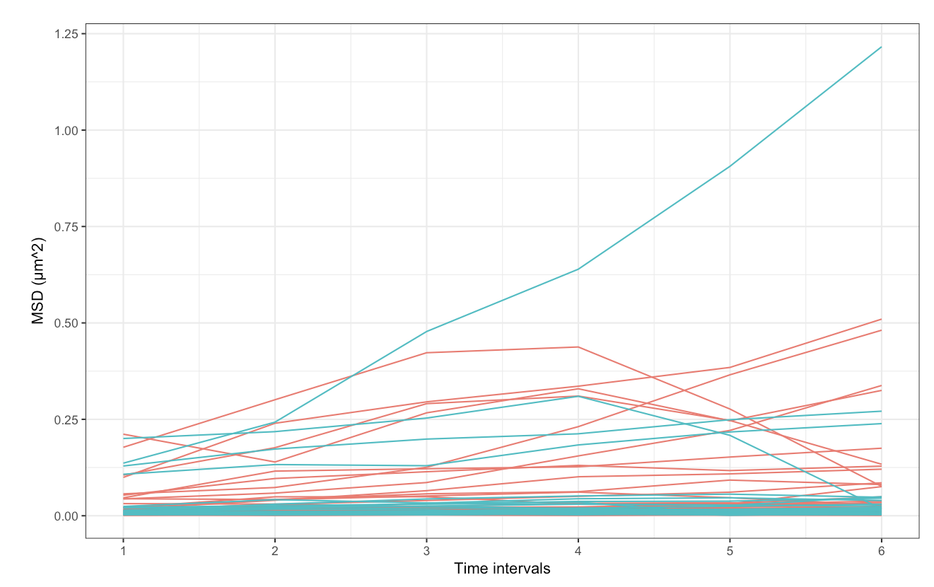
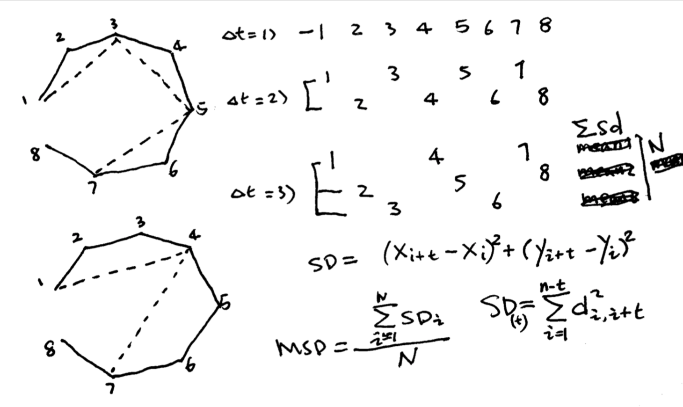
Analyzing Data
Mean squared displacement

Slide 21
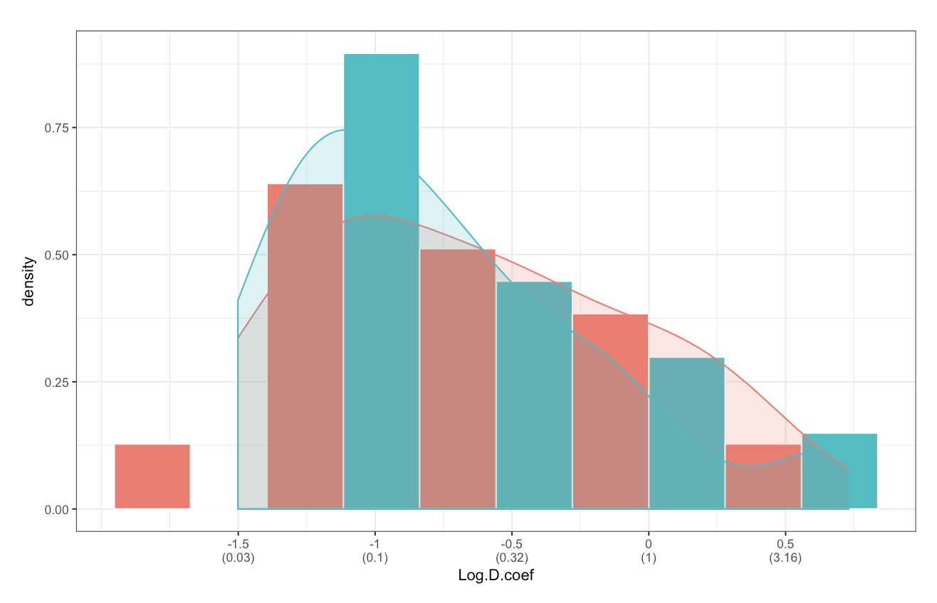
Analyzing Data
Diffusion coefficient

Slide 22
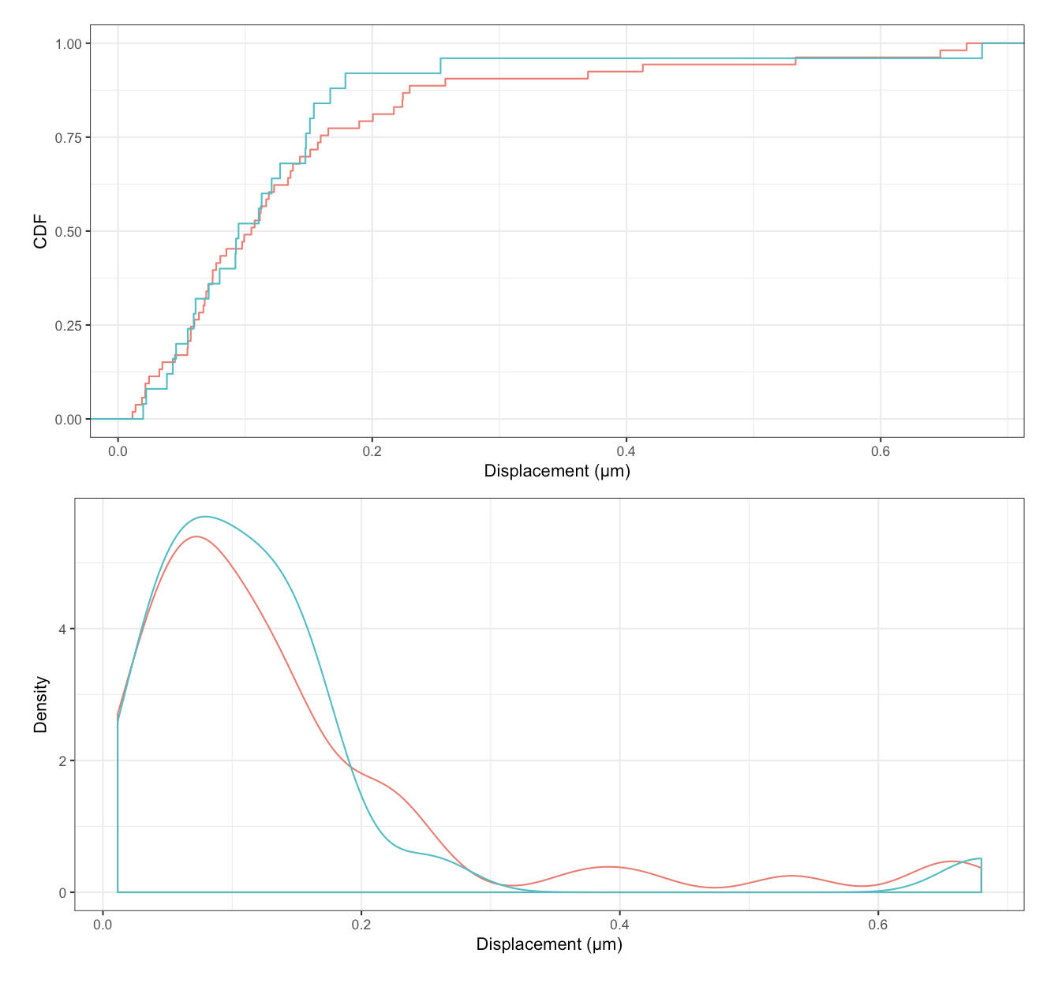
Analyzing Data
Cumulative distribution function

Slide 23
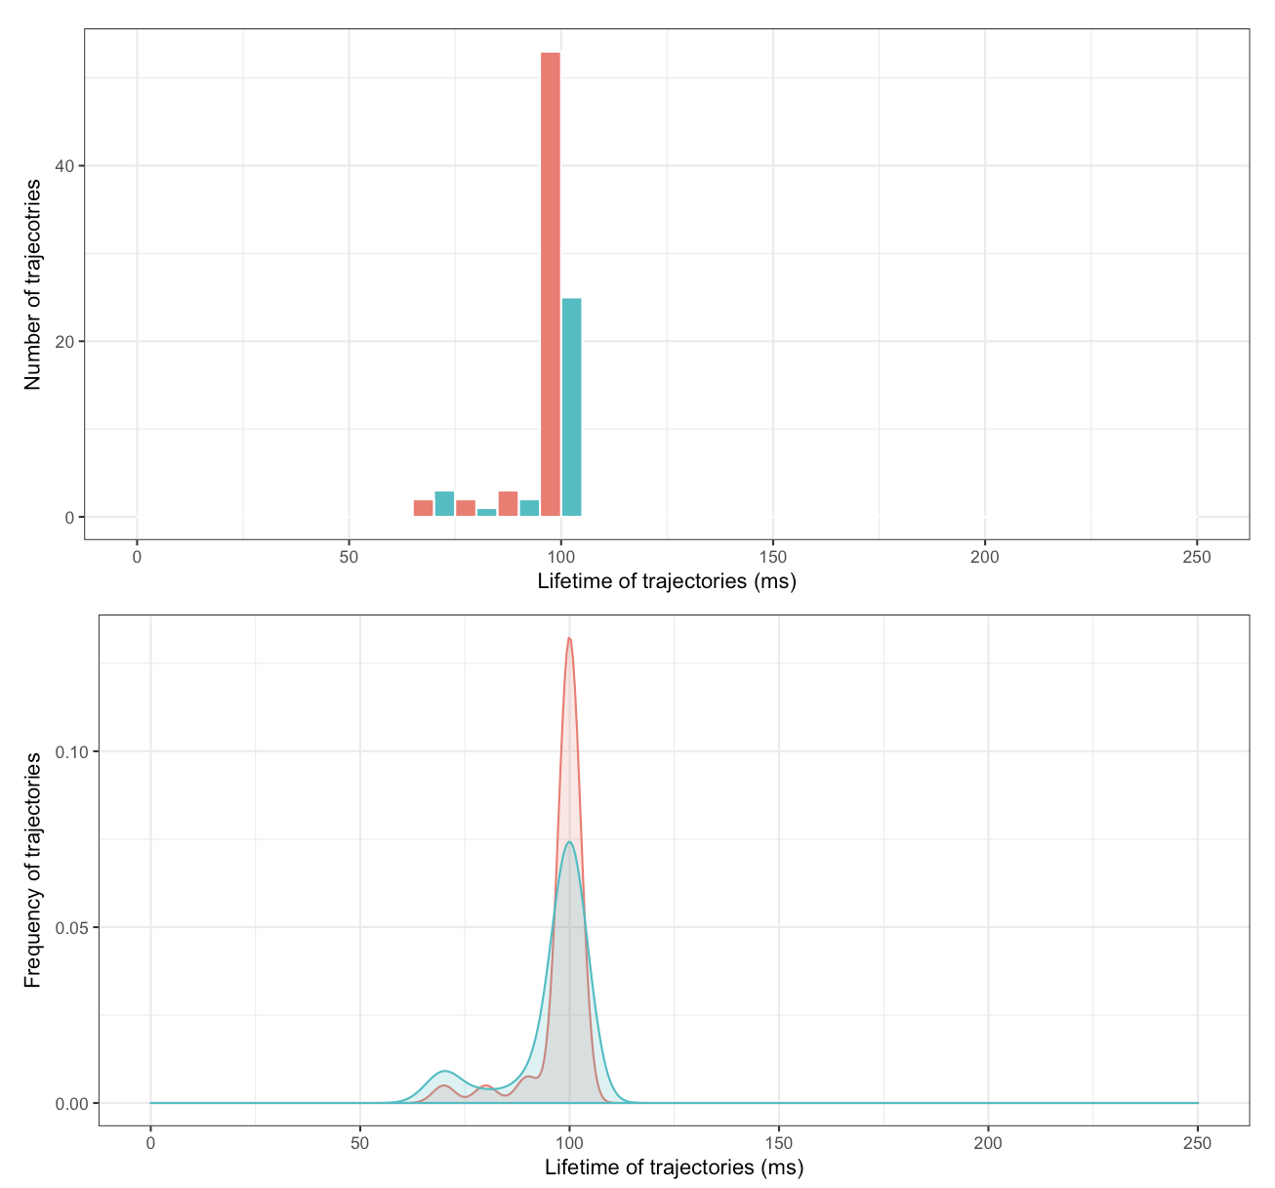
Analyzing Data
Dwell time

Slide 24
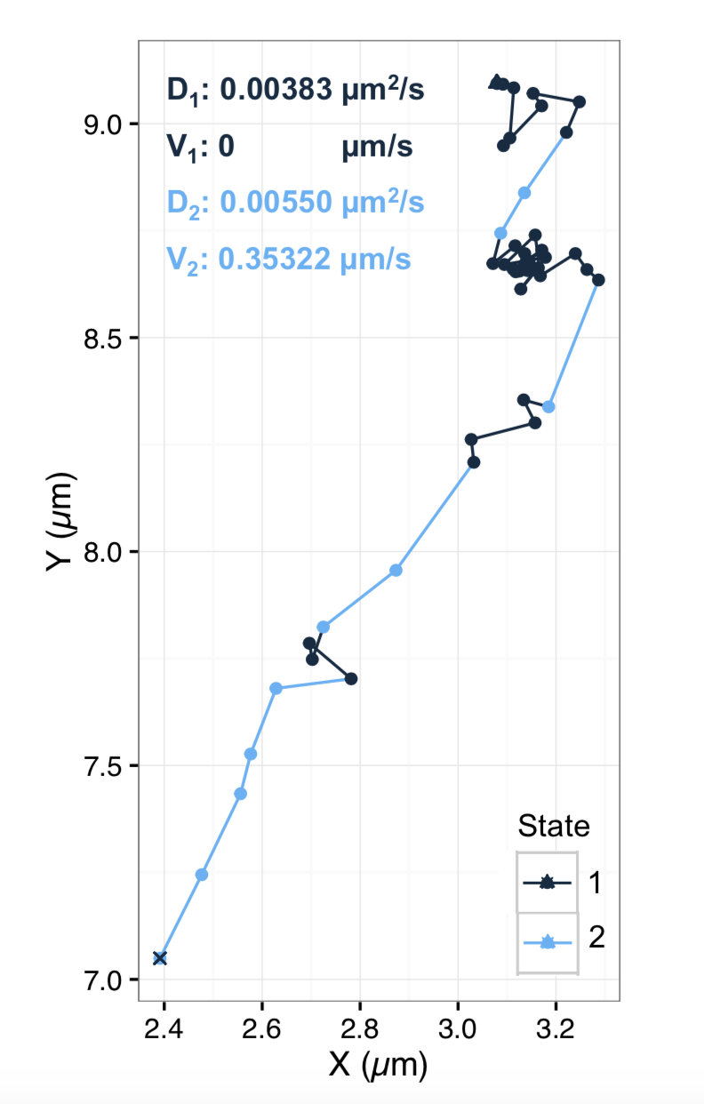
Analyzing Data
Hidden Markov models

Slide 25
Discussion

Slide 26
Acknowledgements
PI
Prof. Carl Wu
Prof. TJ Ha
Prof. Michael Schatz
Post-Docs
Sheng Liu
Anand Ranjan
Vu Nguyen
Jee Min Kim
Xiaona Tang

